Slide 1
Architecture Collaboration Team Technology Impact Assessment
Date: 11-Feb-2016
Presented by: Micah Kalen
To: Architecture Collaboration Team
Project Gate: Design_Deliver
Version: 1.0
Project:
AFE 008180
Operations Communications Web

Slide 2
Context: Recap Project Scope
We are looking to deploy an internal, “dropbox”-like service for store managers for basic operational related documentation such as product recalls, OH&S forms, visual merchandising process etc. This website currently exists today but limited utility to the business. As a result we continue to rely on daily, weekly, monthly, etc print and courier. The benefit of the website was to replace paper, print and courier costs.

Slide 3

Security Design
Security Questionnaire
For Yes/No answers please place an X into the appropriate column | Yes | NO
Credit Card Holder Data: Does this project involve credit card data or any system that can affect the security of a credit card system including any person or workspace with access to credit card data and any system that protects, monitors or manages credit card data. |  | X
Describe the data classification that this project will be introducing? INTERNAL
Is there a requirement for the application or data to be Internet facing? |  | X
Will the data be shared, and if so with whom? | NO
Where will this data be stored? | INTERNAL
Once design is finalized contact Security governance to determine if
a risk assessment is required

Slide 4
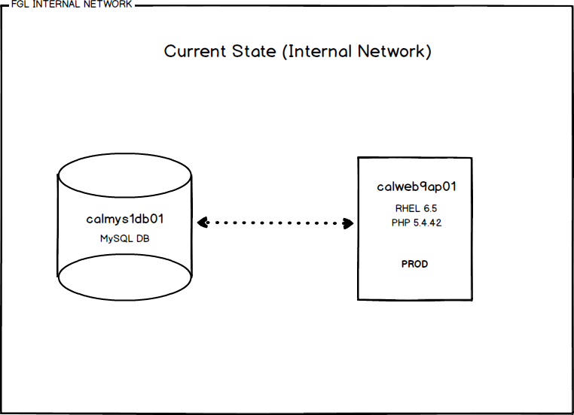
System Context/Current State
Include a brief picture on current state if applicable

Slide 5
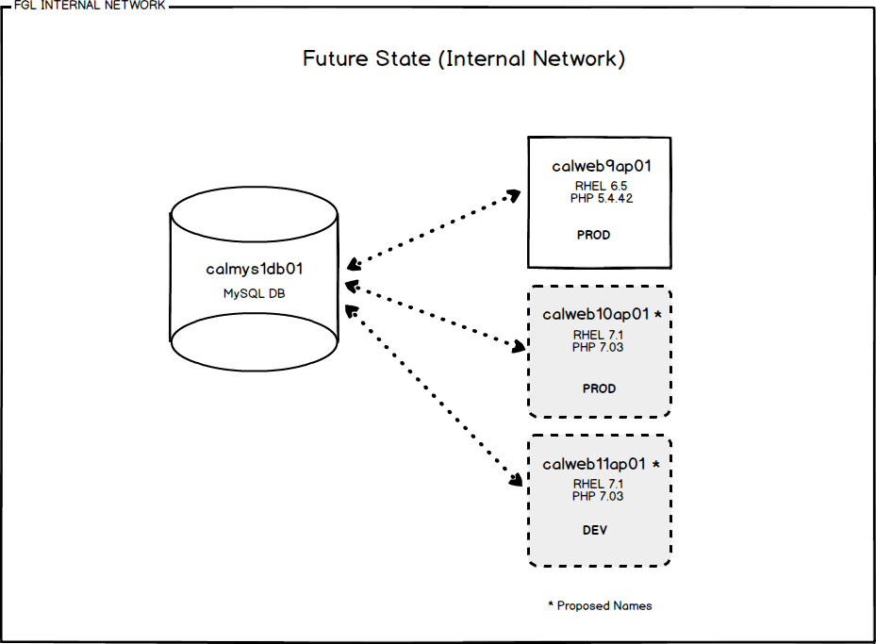
Recommended Solution
Include a brief picture on the solution being recommended. Provide the available details to the design including the Disaster Recovery tiering and design.

Slide 6
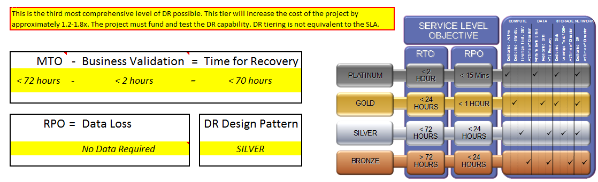
Disaster Recovery and Business Continuity

